Slide 1

ICT ENGINEERING PROPOSAL
ICT Vacuum Interlock & Red Alarm System
Preventing False Failures & Protecting Yield via SMC ZSE20 Real-Time Pneumatic Monitoring
PREPARED BY
LOCATION / SITE
TARGET SYSTEM
ICT Test Engineer
Jabil Manufacturing Line
ICT Vacuum Test Fixtures

Slide 2
Problem Statement & Impact
Unnoticed vacuum drops during In-Circuit Testing lead to poor pogo-pin contact, generating false rejections, unnecessary troubleshooting, and line downtime.

Slide 3

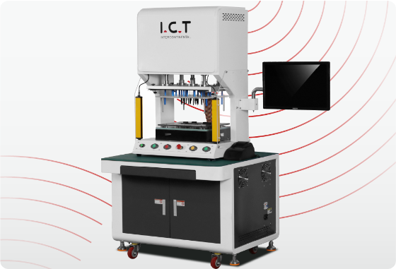
Vacuum Loss in ICT Testing
Operational Challenges
Operators frequently fail to notice gradual or sudden drops in vacuum levels during fixture actuation.
Insufficient vacuum pressure leads to incomplete PCBA pull-down, causing open/short pogo-pin contact errors.
Boards are misdiagnosed as defective, resulting in false failures and unnecessary scrap/re-work logs.
Retesting false-failed units reduces line throughput and wastes valuable ICT capacity.

Slide 4
Root Cause Analysis
Lack of Visual / Audible Indication
No Automated Test Interlock
Standard vacuum gauges are small and positioned inside or behind test cabinets. Operators focus on the test monitor display and cannot observe pneumatic drift during active board loading.
The ICT program executes regardless of vacuum pressure integrity. If pressure dips mid-test, the software reports component failures rather than flagging a pneumatic utility fault.

Slide 5





Key Project Objectives
Precision Monitoring
Instant Visual Alert
Zero False Failures
Integrate SMC ZSE20 digital vacuum sensor for continuous, highly accurate pressure threshold evaluation.
Trigger a prominent red alarm tower light & audible buzzer when vacuum pressure drops below operational limits.
Prevent test execution during pressure drops, ensuring only genuine electrical defects are flagged.

Slide 6
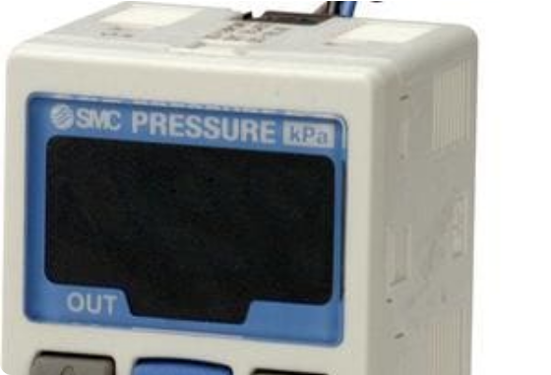
SMC ZSE20 Switch Capability
Sensor Capabilities & Features
Range & Display: 0.0 to -101.0 kPa range with 3-screen 3-color digital readout.
Fast Response: Short delay time (< 1.5 ms) catches instantaneous vacuum leaks.
Dual Output (NPN/PNP): Programmable digital switch outputs with hysteresis mode.
Set-Point Control: Configurable vacuum limit (e.g., alert triggered at < -65 kPa).

Slide 7
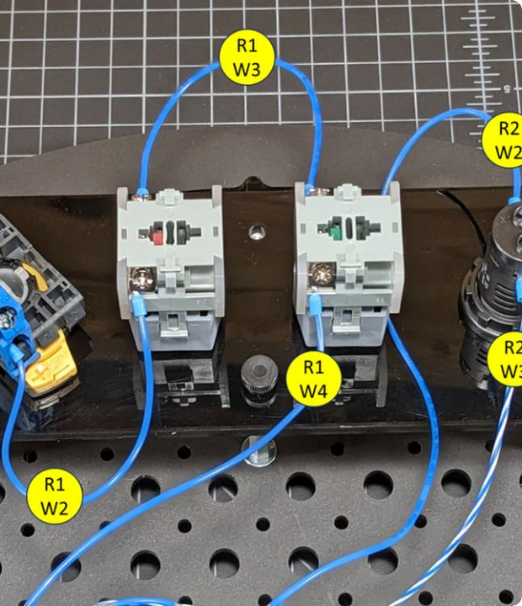
Relay Interlock Circuit Design
Electrical Circuit Logic
The SMC ZSE20 digital output (Black wire OUT1) drives a 24V DC miniature industrial relay coil (A1/A2) protected by a freewheeling diode.
When vacuum falls below threshold, the relay switches contacts to power a 24V Red Alarm Beacon / Siren and opens the ICT Start Interlock signal line.

Slide 8
Target ROI & Failure Reduction
Quantifiable Production Gains
0%
Eliminates false rejections caused by vacuum drops, reducing false failure rates to near zero.
Saves an estimated 15-20 hours per month of engineering re-test and false defect troubleshooting time per ICT line.
Pneumatic False Failures

Slide 9
Bill of Materials & Cost Estimate
Item Description | Model / Spec | Qty | Est. Cost ($) | Purpose
SMC Digital Vacuum Switch | ZSE20-N-01-L (NPN) | 1 | $110.00 | Precision pressure monitoring & switching output
24V DC Relay Module | Omron MY2N-D2 / Finder 40 Series | 1 | $15.00 | Switches high current for alarm tower & signal interlock
Red LED Alarm Tower + Buzzer | 24V DC Industrial Beacon | 1 | $35.00 | Visual/audible operator warning light
Pneumatic T-Fittings & Tubing | SMC KQ2H 6mm One-Touch | 1 set | $12.00 | Inline connection to main fixture vacuum line
Wiring, Enclosure & Terminal Block | Standard Panel Mount Box | 1 set | $25.00 | Safe electrical enclosure & clean wiring layout

Slide 10
Project Implementation Plan
Week 2
Week 4
Relay & SMC ZSE20 wiring, threshold programming (-65 kPa).
Operator briefing, SOP release & full line roll-out.
Week 1
Week 3
BOM procurement & panel mechanical enclosure prep.
Pilot installation on 1 ICT station & off-line validation.

Slide 11
SOPs & Maintenance Controls
Key Lock Protection: Activate password key-lock on SMC ZSE20 to prevent unauthorized threshold editing by line operators.
Calibrated Thresholds: Standardize low-vacuum trip point at -65 kPa (with 5 kPa hysteresis) across all ICT vacuum fixtures.
Shift Start Verification: Add a 5-second vacuum alarm check to daily operator PM checklist prior to production runs.
Preventive Maintenance: Clean pneumatic filter cups monthly to ensure swift response times and clean sensor tubing.

Slide 12
Summary & Approval
Ready to implement on Pilot ICT Line 1 with minimal investment ($197/station).
Jabil ICT Engineering Department | Open for Q&A

Slide 13




Image Sources
https://ikrorwxhnjmplp5m-static.micyjz.com/cloud/jqBprKknloSRjkqinpmoiq/ICT-Tester-Q518D.png
Source: www.smtfactory.com
https://www.smcpneumatics.com/images/5031.jpg
Source: www.smcpneumatics.com
https://global.discourse-cdn.com/digikey/original/3X/1/4/1433fc1a772b64f4367f4789ec038d7b9084306f.jpeg
Source: forum.digikey.com

